Slide 1
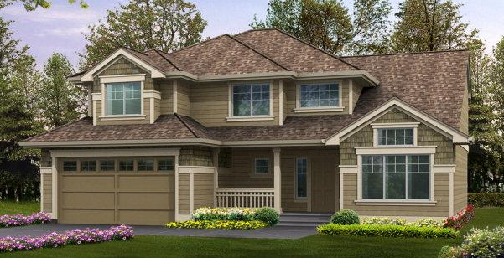
I86 Innovation Corridor Housing Study:
Single-family and Market Rate Rental Housing
Three Rivers Development Foundation
July 2017

Slide 2
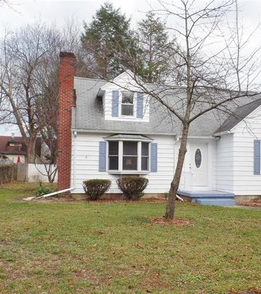
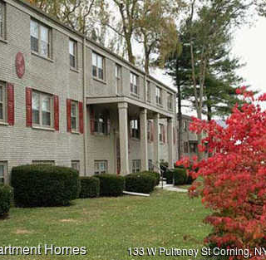
Purpose and Scope of the Study
Assess impact of economic factors and market trends on supply/demand in
single-family and market rate rental housing
Project gaps
Identify issues and opportunities for revitalization and new construction
Recommend action steps

Slide 3
Geographic Area
SE Steuben County
City and Town of Corning
Village of Riverside
Town of Campbell
Town of Erwin, including Painted Post
Town of Hornby
Town of Lindley
Western Chemung County
City and Town of Elmira
Village of Elmira Heights
Town and Village of Horseheads
Town of Big Flats
Schuyler County
Village of Watkins Glen

Slide 4
Single-family Housing
Part 1

Slide 5
National Trends in Single-family Housing
Robust pace of home sales
Sales at all price points: highest concentration in $200,000 – $299,000 and $300,000 - $399,999
New construction in NE: +10% over 2016
Result:
  New construction barely keeping up with demand (<6 mos)
  Low inventory of existing houses (<4 months)
  Driving existing home prices to 4.8% increase in 2016
  Forecasted at 3.6% - 4% in 2017
  Increased investment in upgrades and renovation of older stock

Slide 6


National Trends in
Single-family Housing
Who is buying? … All consumer groups
Millennials (24-36) who are first-time home buyers --- largest group
37 – 51 year olds moving-up; many buying multi-generational houses
Empty nesters who are down-sizing

Slide 7
Millennials
43% of Millennials have bought their homes
75% of non-homeowners could be motivated to buy a house
45% have student loan debt with median balance of $25,000
Prefer new construction or older houses with character
Most envision moving to a new city fewer than 2 times in their lives
68% prefer to build a life in one community, rather than live and work in multiple places
Albany and Buffalo-Niagara are among top 10 destinations in U.S.

Slide 8
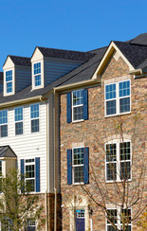
New York State Trends
Pace of housing market is mixed outside of NYC Metro Area
Between 2007 – 2016
  Home sales fell 12% from 101,000 to 89,144
  Median sales price fell 9% from $236,000 to $215,000
  60% of communities are seeing increase in 2017
Syracuse and Binghamton rank high in US for affordability (based on median income)
Albany and Buffalo-Niagara Area lead with both existing home sales and new construction
New construction activity in Syracuse, Rochester, Long Island, Kingston, Albany, Buffalo

Slide 9
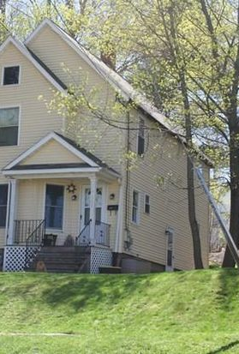
I86 Corridor Area Trends
2016 Sales Stats
  Largest number: $100,000 – $200,000 price range
  Quickest selling: $60,000 - $70,000, $140,000 - $160,000 and $500,000+
  DOM: 108 (compared to 178 in 2014)
  Median sales price: $119,900
  Average sale price: $140,824; up 5-10% from 2015
  Closings: 1,456 in 2016; up 5.5% from 2015
2017 Trends
  Pace of sales level with 2016 due to low inventory
  Average DOM: 96
  Shortage of inventory driving up prices
  Housing values continue to appreciate …. making homeownership a good investment

Slide 10
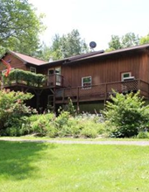
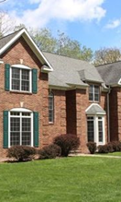
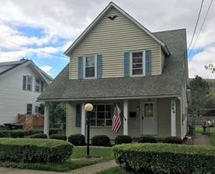

Dynamics in the I86 Corridor Market Place
“Stagnant Internal Domino Effect”
Increase in first-time homebuyers in $80,000-125,000 range
Turnover stunted by 65+ remaining in $90,000 - $150,000 houses
Demand among persons wanting to move up from starter houses to $150,000 – 175,000 … limited inventory
Owners of houses in $120,000 – 175,000 range wanting to move up to $225,000-300,000 range … lack of inventory and concern about increased property taxes
In-migration demand
1, 000 - 1,600 new jobs forecasted for next 12 – 36 months
< 5-mo supply in target price points … increasing stress on market
Forecast demand among new workers: 150-200 units
Former excess inventory in $400,000 + range being absorbed by new upper management and healthcare professionals, and existing residents “moving up”

Slide 11





Consumer Groups
Executives, Senior Management and Healthcare Professionals ( 40)
Established Professionals and Upper Management (200)
Mid-career Professionals and Middle-management (260)
Young Professionals (200)
Empty Nesters
Other First-time Home Buyers such as tradesmen, productions workers, customer services representatives and administrative support team members

Slide 12
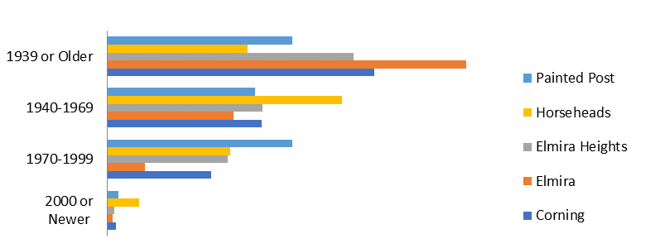
Capacity to Respond
Existing Housing Stock
  60% built prior to 1969
  50% built prior to 1940 in Corning and Elmira
  Require $40,000 - $50,000 in upgrades

Slide 13
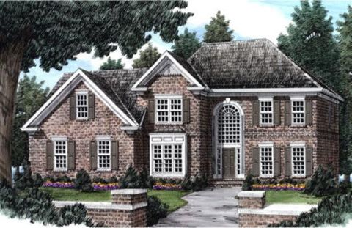
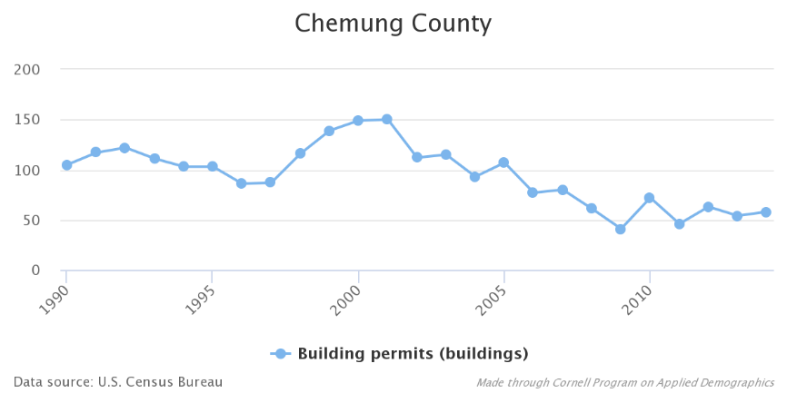
Capacity to Respond
New Construction
Shortage of experienced residential home builders
Building 1-2 custom and spec houses at a time
Six custom built houses under construction … $600,000+
Inventory of buildable lots depleted by mid-2018
Potential for 180-200 building lots in Town of Erwin

Slide 14
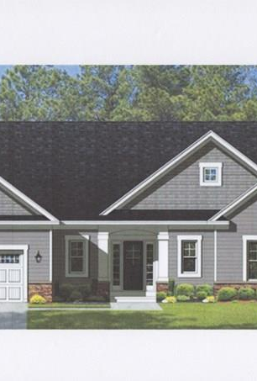
Widening Gap
Gap in Demand to Meet Job Growth:
$125,000 - $175,000: 40
$175,000 - $225,000: 65
$225,000 - $275,000: 75
$275,000 - $350,000: 85
$350,000 – $500,000+: 25
Gap in Supply for Total Market:
200-250 new construction single-family houses in next three years at $225,000 – 350,000 price point
Inventory has reached its lowest point since 2008!

Slide 15
Market Rate Rental
Part 2

Slide 16

National Trends
26% of all households are renters
Average rent: $1,315 … 3.3% increase over 2016
Vacancy Rates: 8.8% in South, 7.8% in Midwest, 5.7% in NE, 4.7% in West
Highest vacancy rate: Class A apts … highest point over past 5 yrs
Average vacancy rates outside MSA’s average: 8.7%

Slide 17
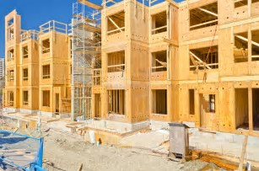
National Trends
Demand for New Construction : 325,000 new apts (especially in West) every year between now and 2030
Highest level of demand: Raleigh, Orlando, Austin, Dallas-Ft. Worth, Houston
Why?
Millennials moving out
Aging population
International immigration
Lack of single-family inventory for sale

Slide 18

National Trends
"The demand for affordable rentals already outstrips
supply, and that imbalance will only get worse for a
couple of reasons:
First, demand will increase as the millennial
generation fully enters the housing market, and
Second, those aging baby boomers with minimal
savings will be looking for housing they can afford on
a budget that depends primarily on Social Security."
Steven E. Lawson, President
The Lawson Companies
Virginia Beach, Va.

Slide 19
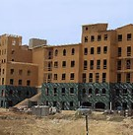
New York State Trends
Largest monthly rent increases
Albany, Canandaigua, Corning, NYC,
Saratoga Springs
Investors attracted to mid-sized metro areas (Albany and Buffalo)
  Average capitalization rate (cap rate)
  Fair market price
  Reasonable maintenance costs
  Potential ROI

Slide 20
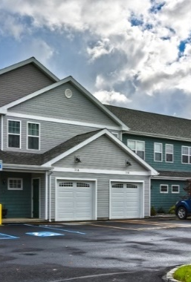
I86 Corridor Trends
1,400 units of market rate housing
(not including single-family houses or low-mod)
Adequate supply of luxury apartments:
  Hickory Grove and Colonial Manor (Horseheads): $995 - $1,895
  WoodsEdge and Emerald Springs (Erwin):
  $1,036 - $2,700
  Market Street and Academy Place (Corning): $950 - $2,200

Slide 21
I86 Corridor Trends
Greatest demand: Young professionals under 35 yrs
Limited supply of moderate rentals: $850 – $1,200
98-100% occupancy
Older complexes:
  Bottcher’s Landing Apartments (Big Flats)
  Quail Bay (Corning)
  Craft Corners Townhouses (South Corning)
 | Average Monthly Rent
Big Flats | $1,120
Corning/Painted Post | $1,233
Horseheads | $1,172
Elmira | $868
Watkins Glen | $736

Slide 22
Capacity to Respond
200 units in planning or construction phase
  Former Corning Hospital Site: 89 apts
  West Water Street Infill Project (Elmira): 54 apts
  Prospect Ridge (Horseheads): 45 apt
Majority expected to be priced above moderate monthly rates

Slide 23
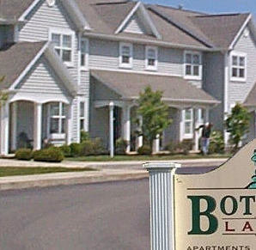
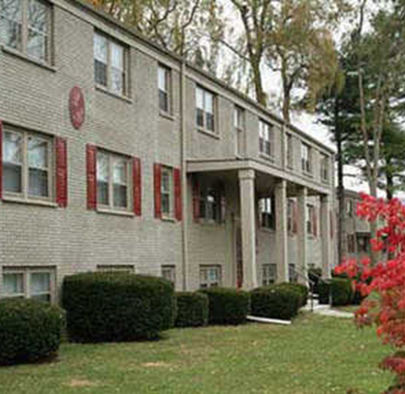
I86 Corridor Unmet Demand
Unmet demand: 140-170 units
1 bedroom: $725 - $805
2-bedroom: $950 - $1,200
Target markets:
  Medical residents (20-25 units)
  Empty nesters (20-25 units)
  Young professionals, middle management & educators(100 – 120)

Slide 24
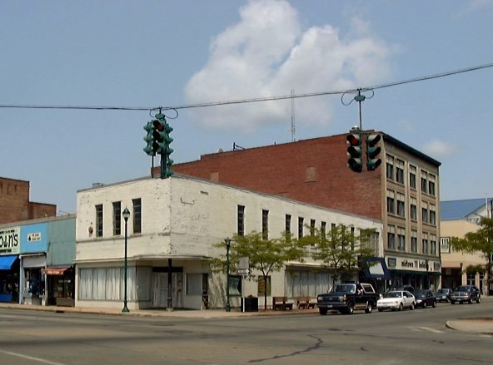
Issues
Issue: Getting price points right and assembling financing package to allow developers to achieve ROI
Cost of New Construction: $100,000 + per unit
High cost of renovation and repurposing historic bldgs

Slide 25
Recommended Action Steps
I86 Innovation Corridor Housing Supply/Demand Analysis

Slide 26
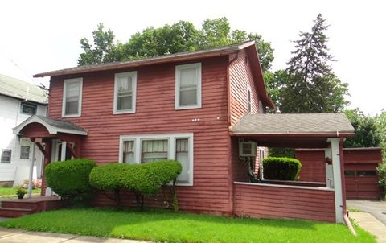
Action Steps: Single-family Housing
Fill single-family housing gap with an aggressive and dual approach
Revitalization of Existing
Housing stock
New single-family
Housing Construction

Slide 27
Revitalize Single-family Housing Stock
Adopt “Placemaking”
as a priority
1
Focus on vacant, undesirable and aged housing stock to increase inventory in the $90,000 – $225,000 range. Leverage vehicles such as Chemung County Land Bank, Corning Housing Partnership, Arbor Housing
2
Create planning and regulatory tools: update zoning and ordinances, offer tax incentives to convert multi-family properties to original use, offer real property tax exemption
3
Infuse cash to expand efforts underway, reduce risk and stimulate private investment: Corning Housing Partnership and Elmira Housing & Neighborhood Revitalization Task Force
4
Secure funding to invest in neighborhood revitalization infrastructure and increase rate of property appreciation
5

Slide 28
Stimulate New Single-family Housing Construction
Strengthen capacity of the building sector to undertake construction on the existing 180-200 building lots in the Town of Erwin and others under consideration in Horseheads and Big Flats: property tax incentives; financing packages that provide small builders with the financial capacity; attract mid-scale building companies that have the capacity to undertake 20+ new house construction
1
Attract private investment and pursue gap financing sources to take advantage of opportunities for construction in the dense urban area on properties targeted for demolition and redevelopment
2
Enhance and extend infrastructure, and motivate developers to increase the number of buildable lots in the Towns of Erwin, Big Flats and Horseheads
3

Slide 29
Action Step: Develop Market Rate Housing at Target Price Points
1 bedroom: $725 - $805 2-bedroom: $950 - $1,200
Pursue adaptive reuse of buildings for upper story apts in urban cores such as Elmira and Villages of Horseheads, Elmira Heights, Painted Post. Consider property tax incentives; leverage land bank properties; develop gap financing packages such as NY Main Street and ESPRI; create zoning to accommodate increased density
1
Attract private investment and pursue gap financing sources to take advantage of opportunities for construction on properties targeted for demolition and redevelopment
2
Foster sufficient critical mass in terms of both number of units and tenants to build confidence in and momentum in the various downtown housing markets so that positive outcomes eventually overwhelm negative externalities
3
Consider lifestyle factors such as pedestrian safety, storage for bikes and outdoor equipment, attached or close parking,, and easy access to a vibrant urban lifestyle in the surrounding area such as retail, restaurants, entertainment.
4
Time development of any new market rate housing units so they are readily absorbed without causing other projects to lose their market viability
5

